Slide 1
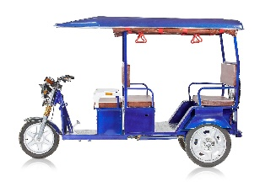
E-rickshaw Management
Submitted to : Mr. Anjani Verma
Assistant Professor in IT
Cluster Innovation Centre, DU
Submitted By Rupabh Bharti | Ashish Jha
B.Tech (IT & MI , 2nd Sem)

Slide 2
Content
Introduction
Problem
The Problem of Mile Connectivity
Solution
Implementation
Future Prospects

Slide 3
Introduction
Delhi NCR is a large area with heavy movement of people within the region. The Delhi metro and DTC play a significant role in facilitating the commute, but the last mile of the commute is still dependent on a E-rickshaw ride.
It is this void – previously dominated by auto-rickshaws after the ban on inhuman manual rickshaws in most of Delhi ,the electric rickshaws have fitted in.
Over the last couple of years, we have seen a large number of these on the road, especially near metro stations.
The e-rickshaws will reduce air-pollution caused by a fossil fuel burning alternative.

Slide 4
Problem
In the last decade, the Delhi Metro has changed the way we travel and the mass rapid transit system carries more than 26 lakh commuters every day across its network spread over 200 km in Delhi NCR.
The metro provides a safe, efficient and comfortable journey but the trouble begins once you step out of its sanitized environment.

Slide 5
The Problem of Last Mile Connectivity
Mostly the problems cited out by metro users is :
  over-crowding in peak hours,
  low frequency of metro feeder services,
  too long walking distance,
  high costs incurred in LMC
  unavailability of proper feeder services at either of the ends
  Unsafe walking environment from/to metro station

Slide 6
Solution
At most Delhi neighborhoods, e-rickshaws have come to occupy the place of the most affordable and comparatively faster modes for last-mile connectivity.
The plan included an effective combination of shared e-rickshaws for last mile connectivity by fixing and delimiting routes.
The Delhi Metro Rail Corporation (DMRC), should partner with e-rickshaw operators for first and last mile connectivity, for short loop services covering 3-4 km routes.
A network of E-rickshaw operators at different locations working in sync with each other is the answer to this problem.

Slide 7
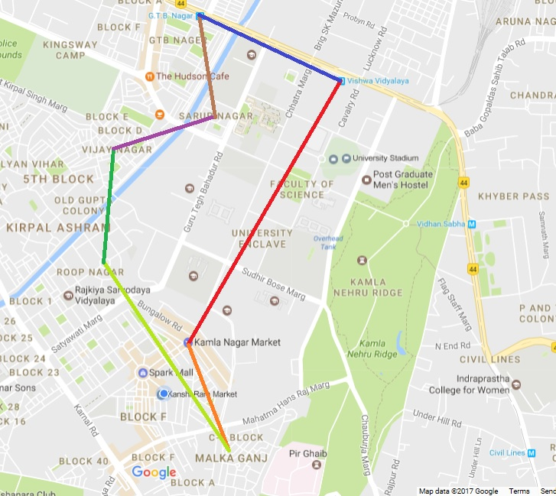

Slide 8
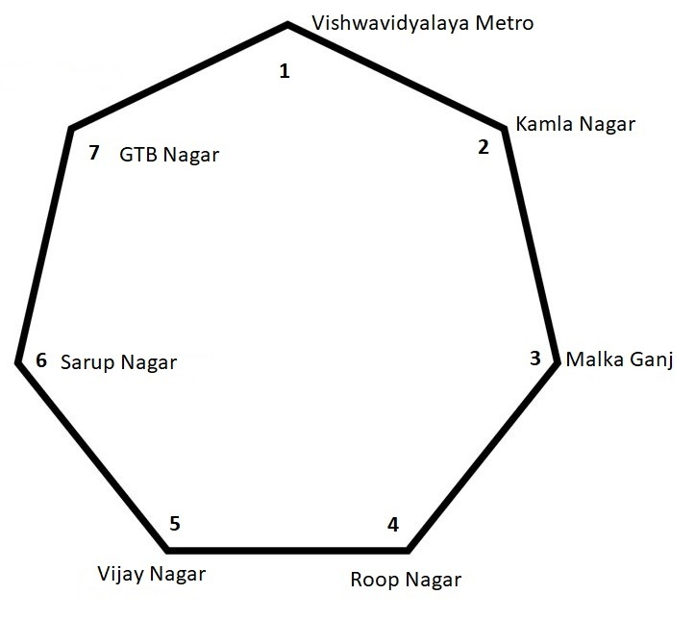
Implementation
We have selected seven locations from the neighbourhood of the metro station which are the major locations of origin of metro commuters.
Then we devised a code for the linking of the chain of E-Rickshaws between these seven points.
The code returns the shortest route with interchange points to the user, after it is provided with the source and destination.

Slide 9
Future Prospects
Going forward I see technology play a vital role in solving the last mile public transport in New Delhi via the e-rickshaws.
The commuters would be able to use a mobile app to order an e-rickshaw ride from her home/office to the metro station/bus-stop and pay cashless via the same for the entire trip.
This will be synced with metro and bus timings so that there is a working connection to each neighborhood from nodal points.
Let’s make Delhi a city famous for a green and efficient public transport system.

Slide 10
THANK YOU

